Slide 1

RETIREMENT PARTY
IN HONOUR OF
Dr Colin Adams

Slide 2
Colin, in your 10 years at the University, you have created a team that has had a transformational effect on the technology sector across the City of Edinburgh and boosted the University’s reputation considerably. A thriving technological community has grown up comprising spin-outs and start-ups from the University and public and private sector businesses attracted to the city by our wealth of talent.
Under your leadership, entrepreneurship has blossomed and attracted major funding, benefitting Informatics, the University and the City. I am delighted that you have won this year’s Principal’s Medal for Contribution to the Community, as you have been a great inspiration and it is very well deserved.
We are very grateful for your tireless commitment, and your enthusiasm and expertise will be sorely missed.
- Professor Sir Timothy O’Shea

Slide 3
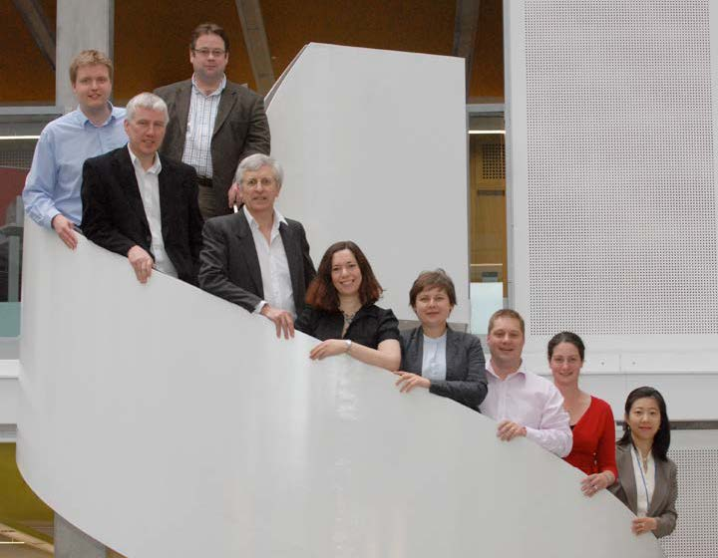
The Original Team

Slide 4
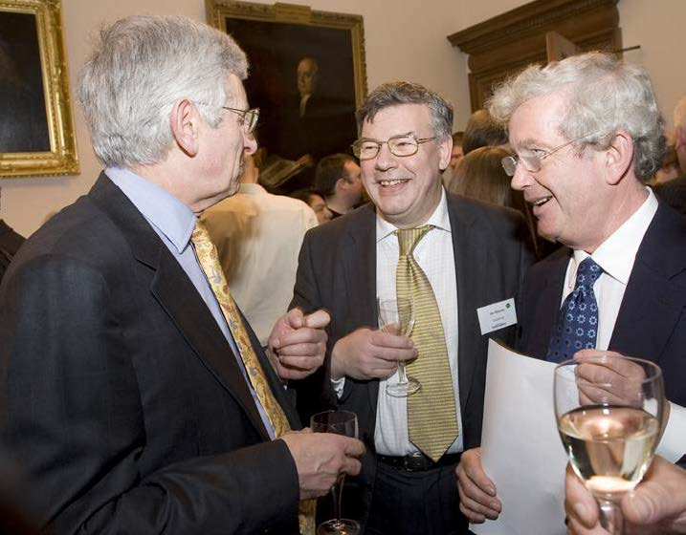

Slide 5
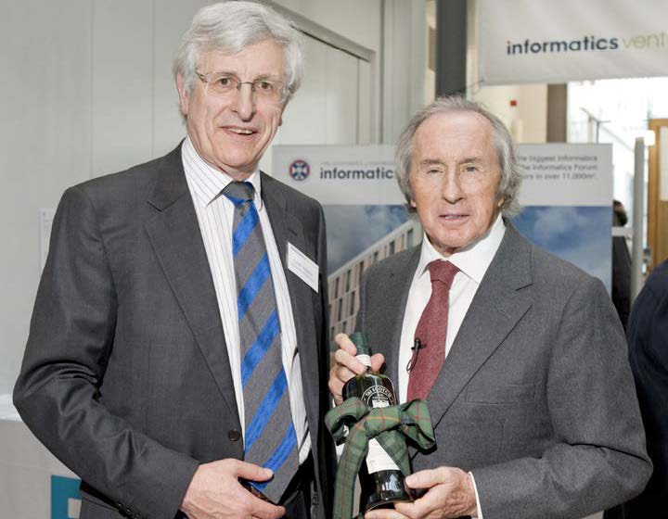

Slide 6
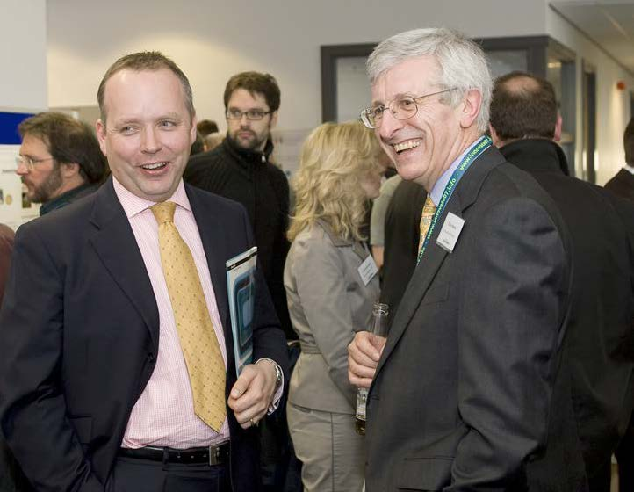

Slide 7
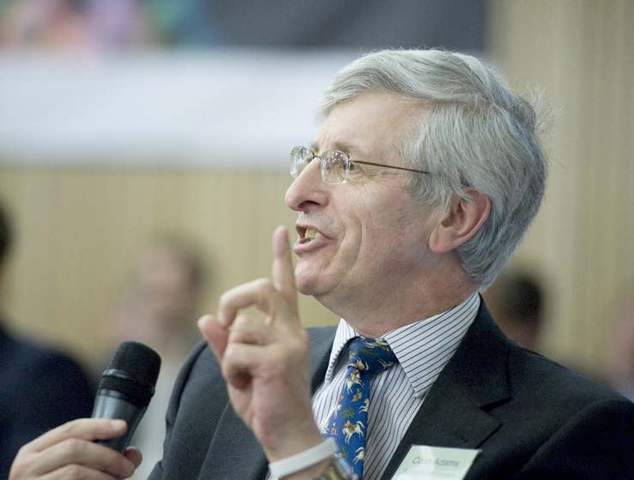

Slide 8
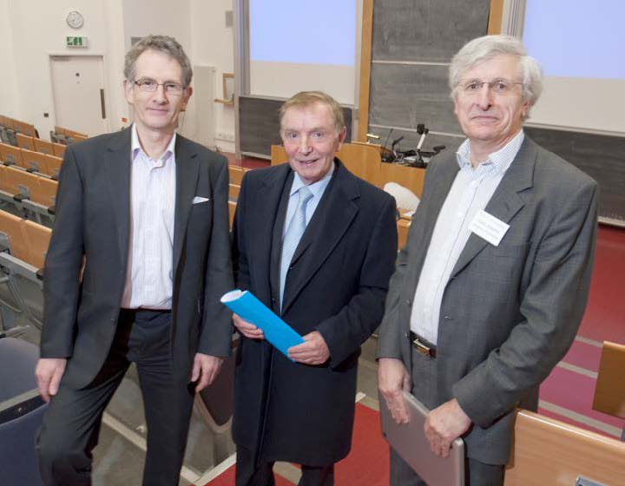

Slide 9
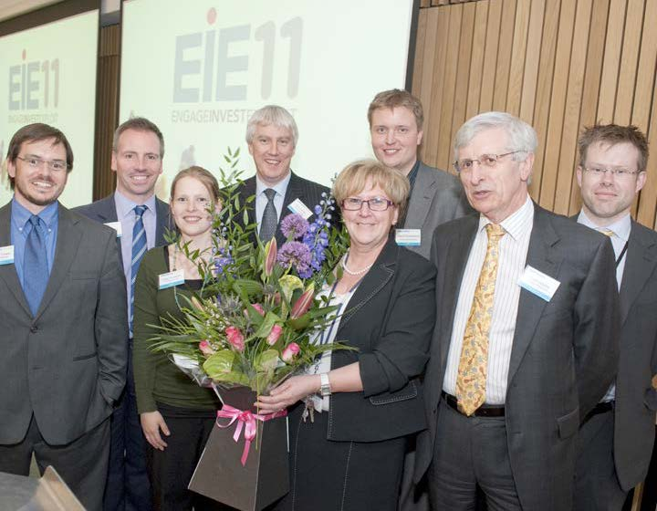

Slide 10
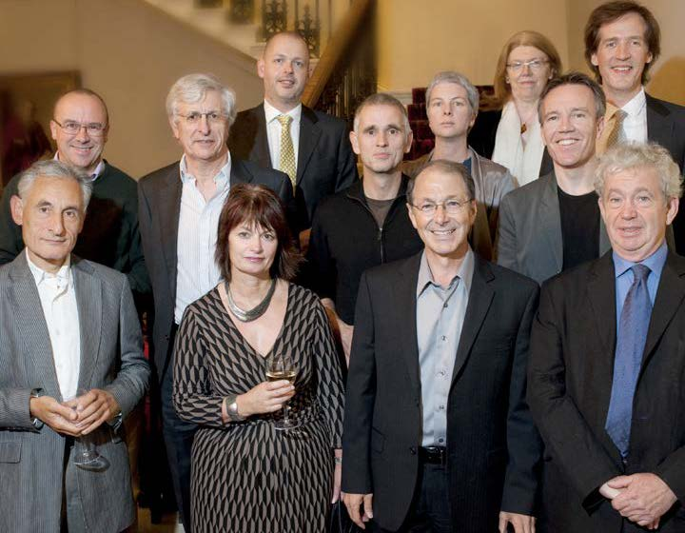

Slide 11
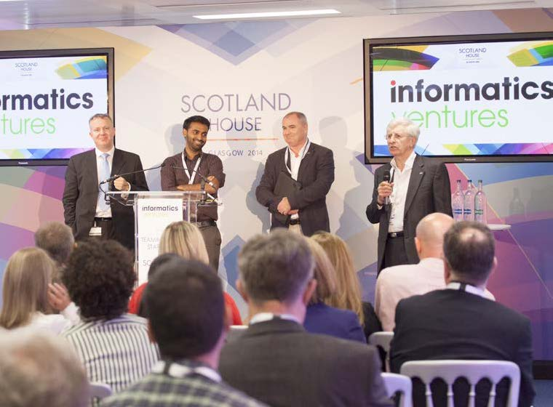

Slide 12
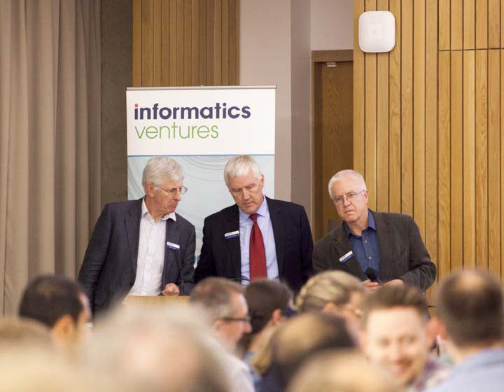

Slide 13
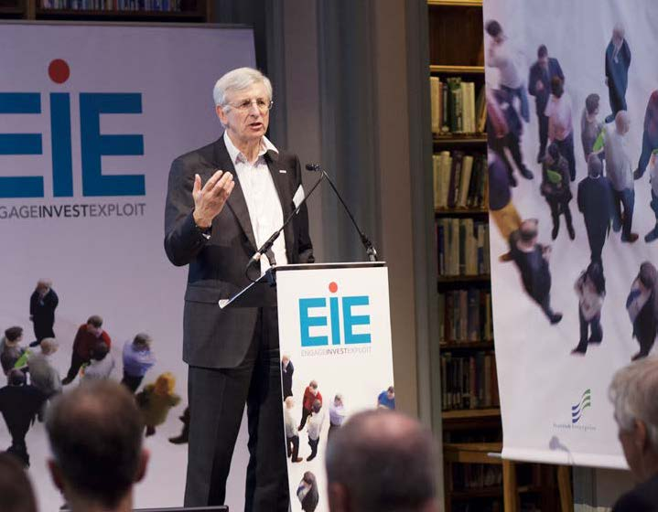

Slide 14
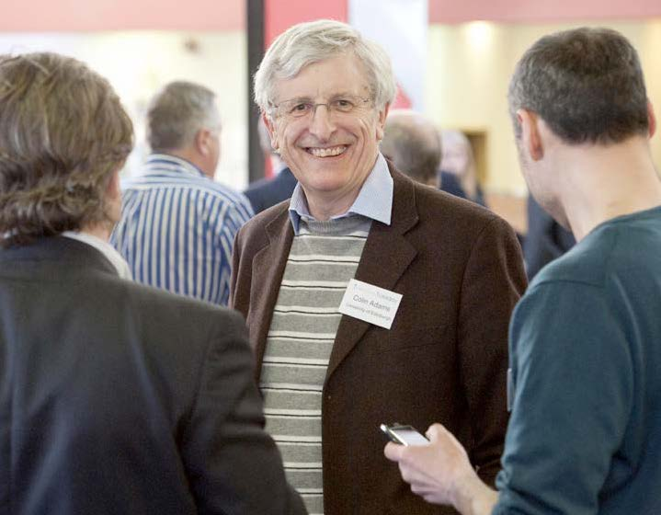
End of an era!

